Slide 1
Superposition

Slide 2
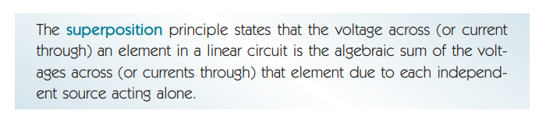

Slide 3
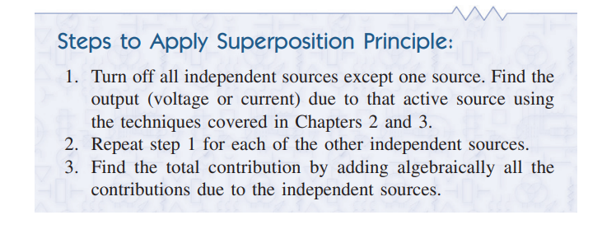

Slide 4
Key points:
Turning off Voltage source: Making it short.
Turning off Current Source: Making it open.
Dependent sources are left intact because they are controlled by circuit variables.

Slide 5
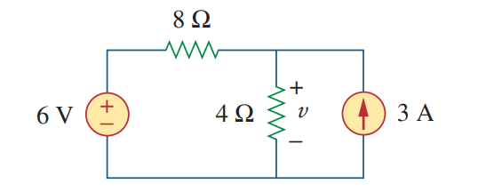
Math Problem Practice:
Use the superposition theorem to find v in the circuit.
Reference: Sadiku_Example_4.3

Slide 6
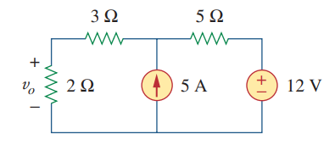
Math Problem Practice:
Use the superposition theorem to find V_{o} in the circuit.
Reference: Sadiku_Practice_Problem_4.3

Slide 7
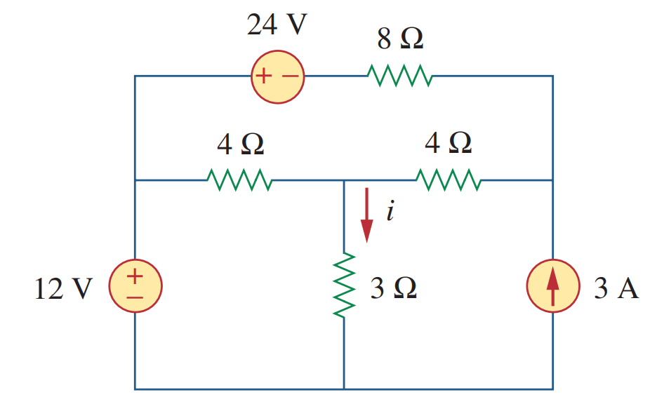
Math Problem Practice:
Use the superposition theorem to find i in the circuit.
Reference: Sadiku_Example_4.5

Slide 8
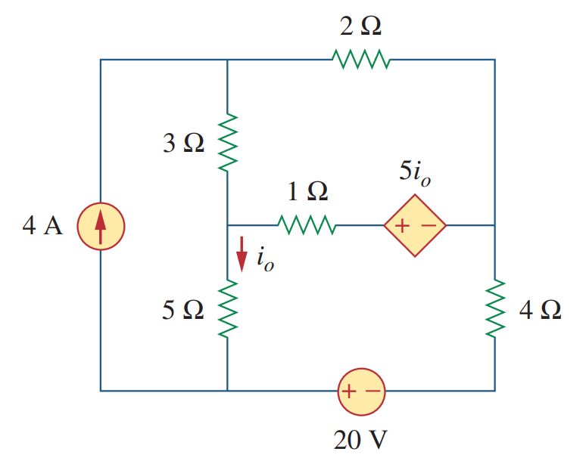
Math Problem Practice:
Use the superposition theorem to find i_{o} in the circuit.
Reference: Sadiku_Example_4.4

Slide 9
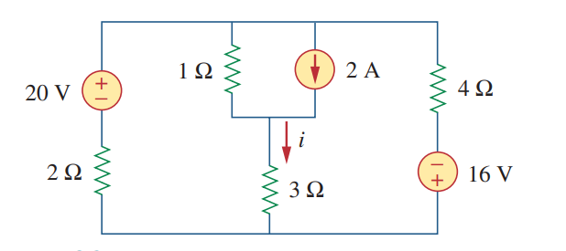
Math Problem Practice:
Use the superposition theorem to find i in the circuit.
Reference: Sadiku_Exercise_Problem_4.15

Slide 10
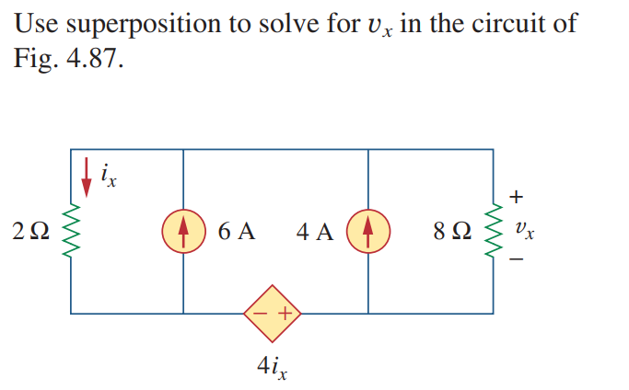
Math Problem Practice:
Reference: Sadiku_Exercise_Problem_4.19

Slide 11
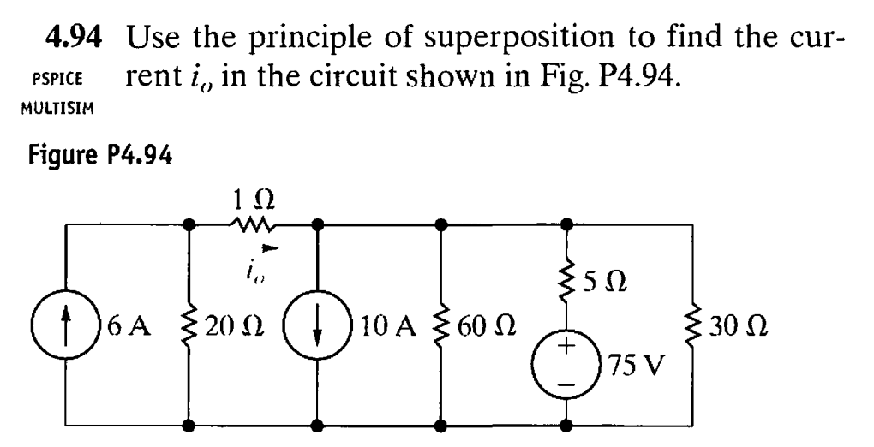
Math Problem Practice:
Reference: Nilsson_Exercise_Problem_4.94

Slide 12
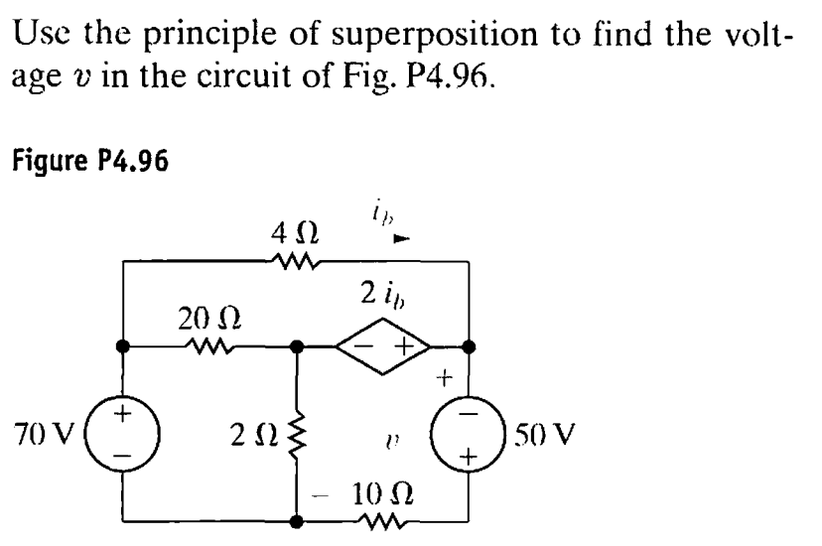
Math Problem Practice:
Reference: Nilsson_Exercise_Problem_4.96

Slide 13
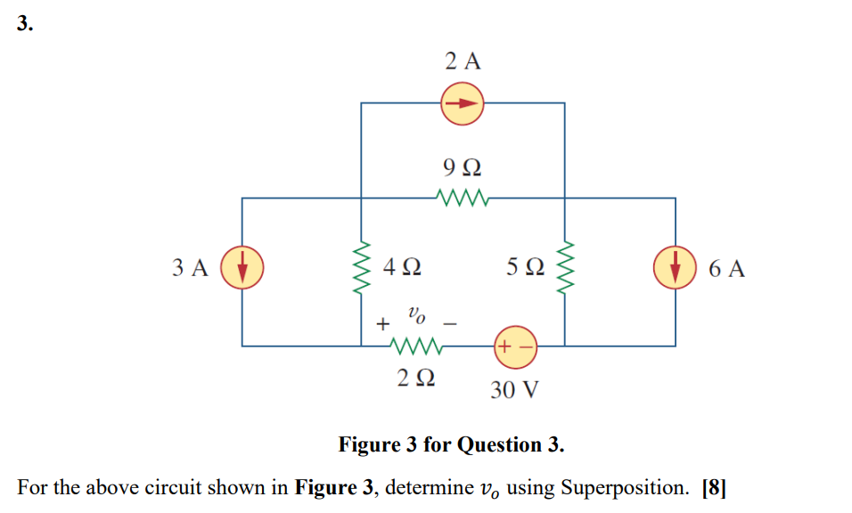
Math Problem Practice:
Fall 2022

Slide 14
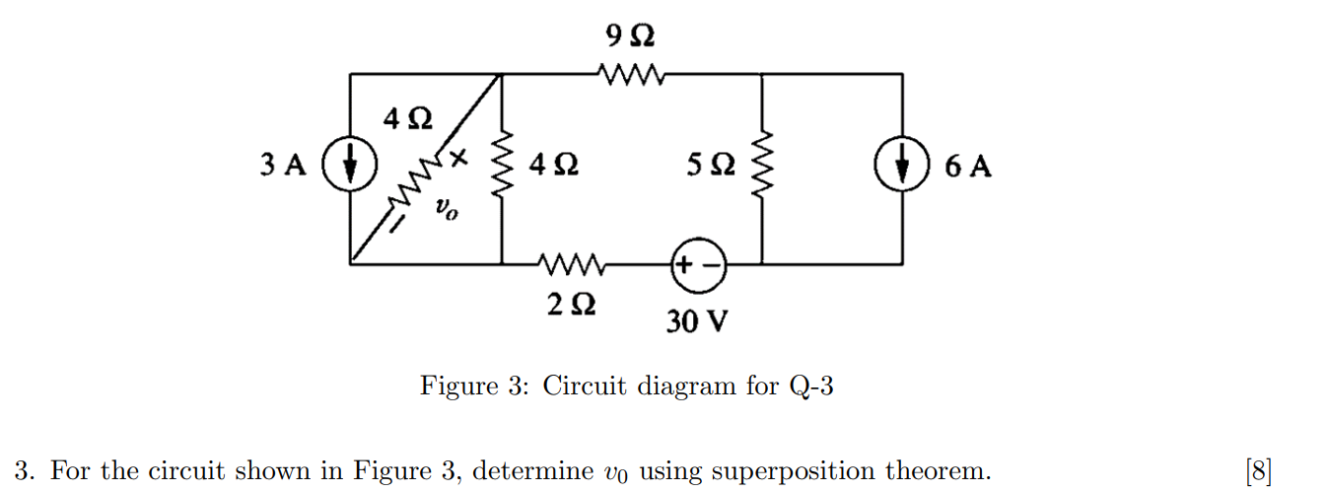
Math Problem Practice:
Summer 2022

